Slide 1
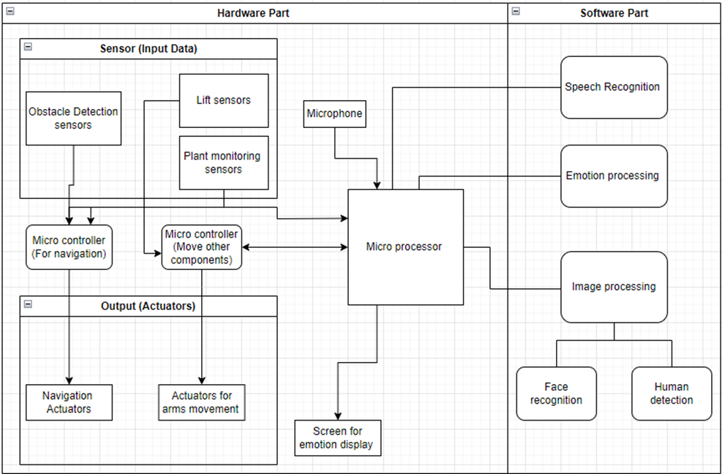
Proposed
design
-
Logical Diagram

Slide 2
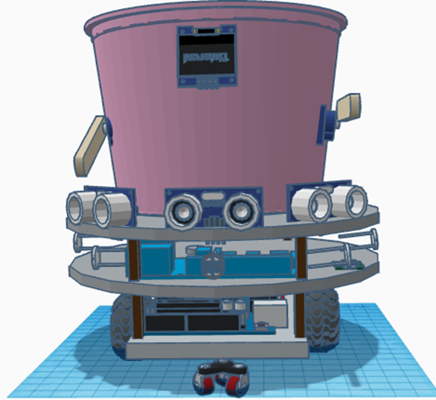
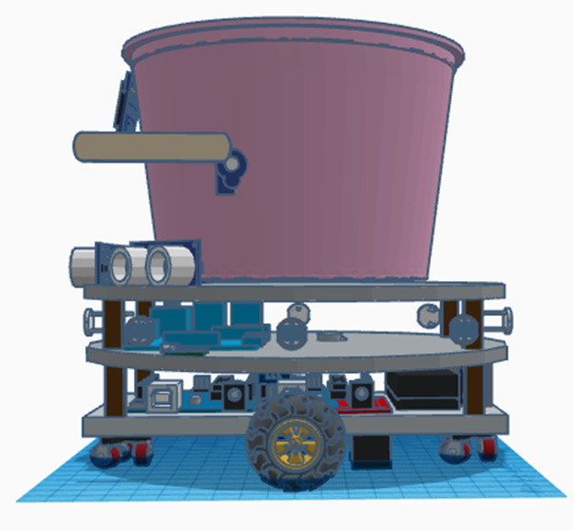
Proposed
design
-
Physical Design
Ultrasonic sensors
Screen
Servo motors connected to arms
DC motors connected to wheels
Caster wheel for rotation and support
LDRs

Slide 3
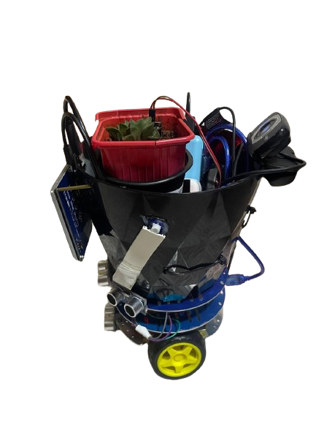
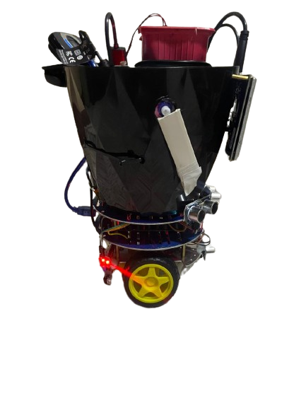
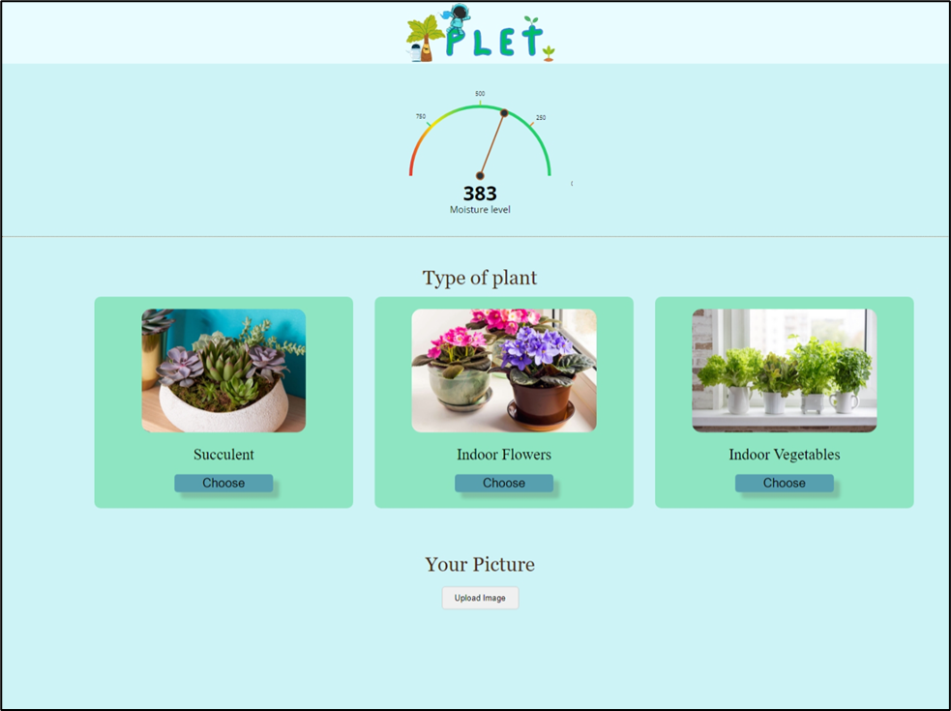
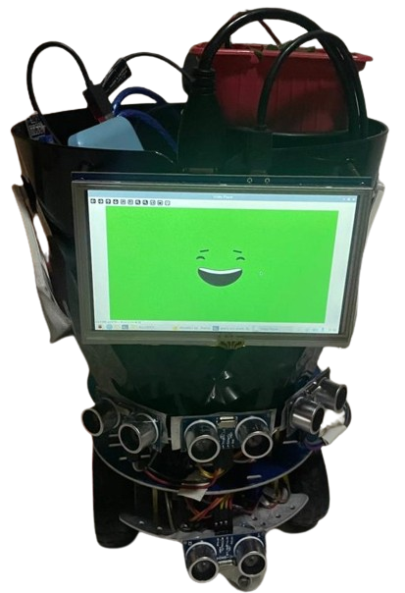
Implementation

Slide 4
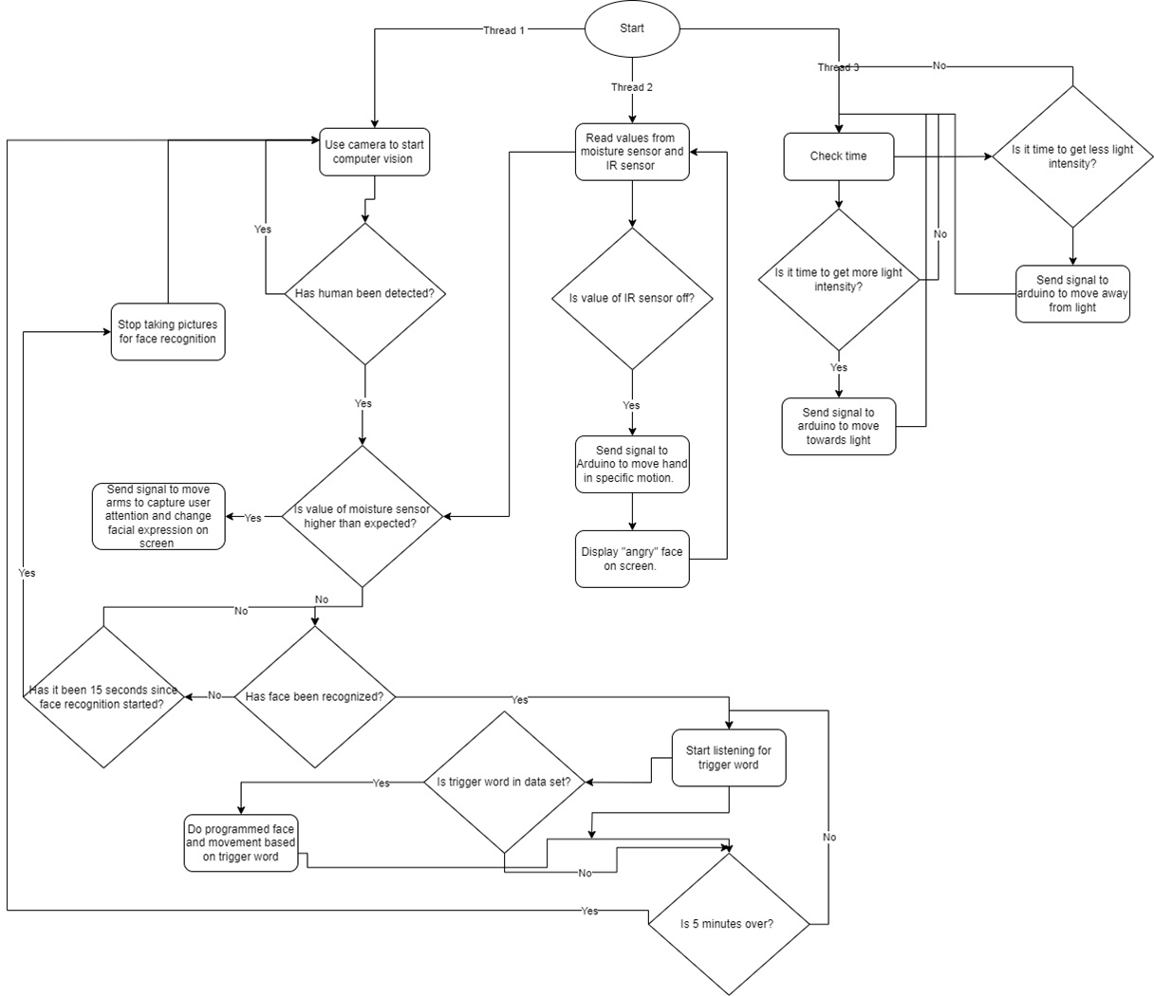
Implementation
Technologies used:
Flask
Python
OpenCV
C++
HTML
CSS
JavaScript

